Slide 1

Restitution Coefficient
By Adam Vasquez

Slide 2
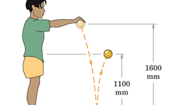
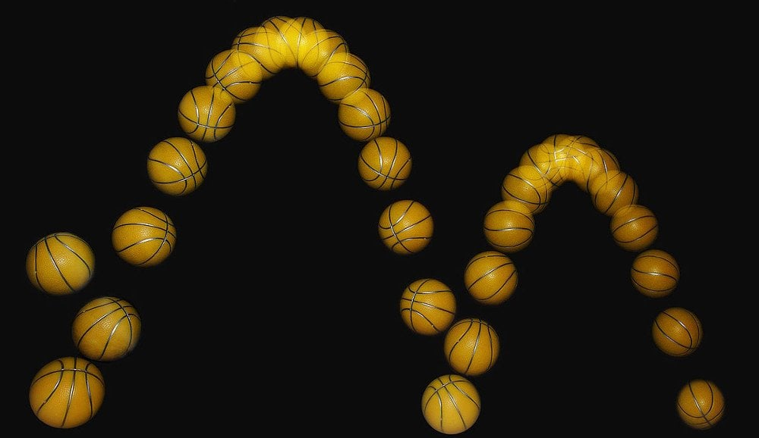
WHAT IS RESTITUTION COEFFICIENT?
The restitution coefficient (e) is defined as the ratio of the final velocity to the initial velocity between two objects after their collision.

Slide 3
What factors influence the restitution coefficient?
The material of the two objects involved in the collision (ex: a rubber ball would have a lower e compared to a heavy metal ball if dropped on the same surface)
The shape of the two objects involved in the collision (ex: If dropped on the same surface, a ball (spherical shape) would lose less velocity compared to a cube of the same material)
Angle? (Will address this later in this presentation!)

Slide 4
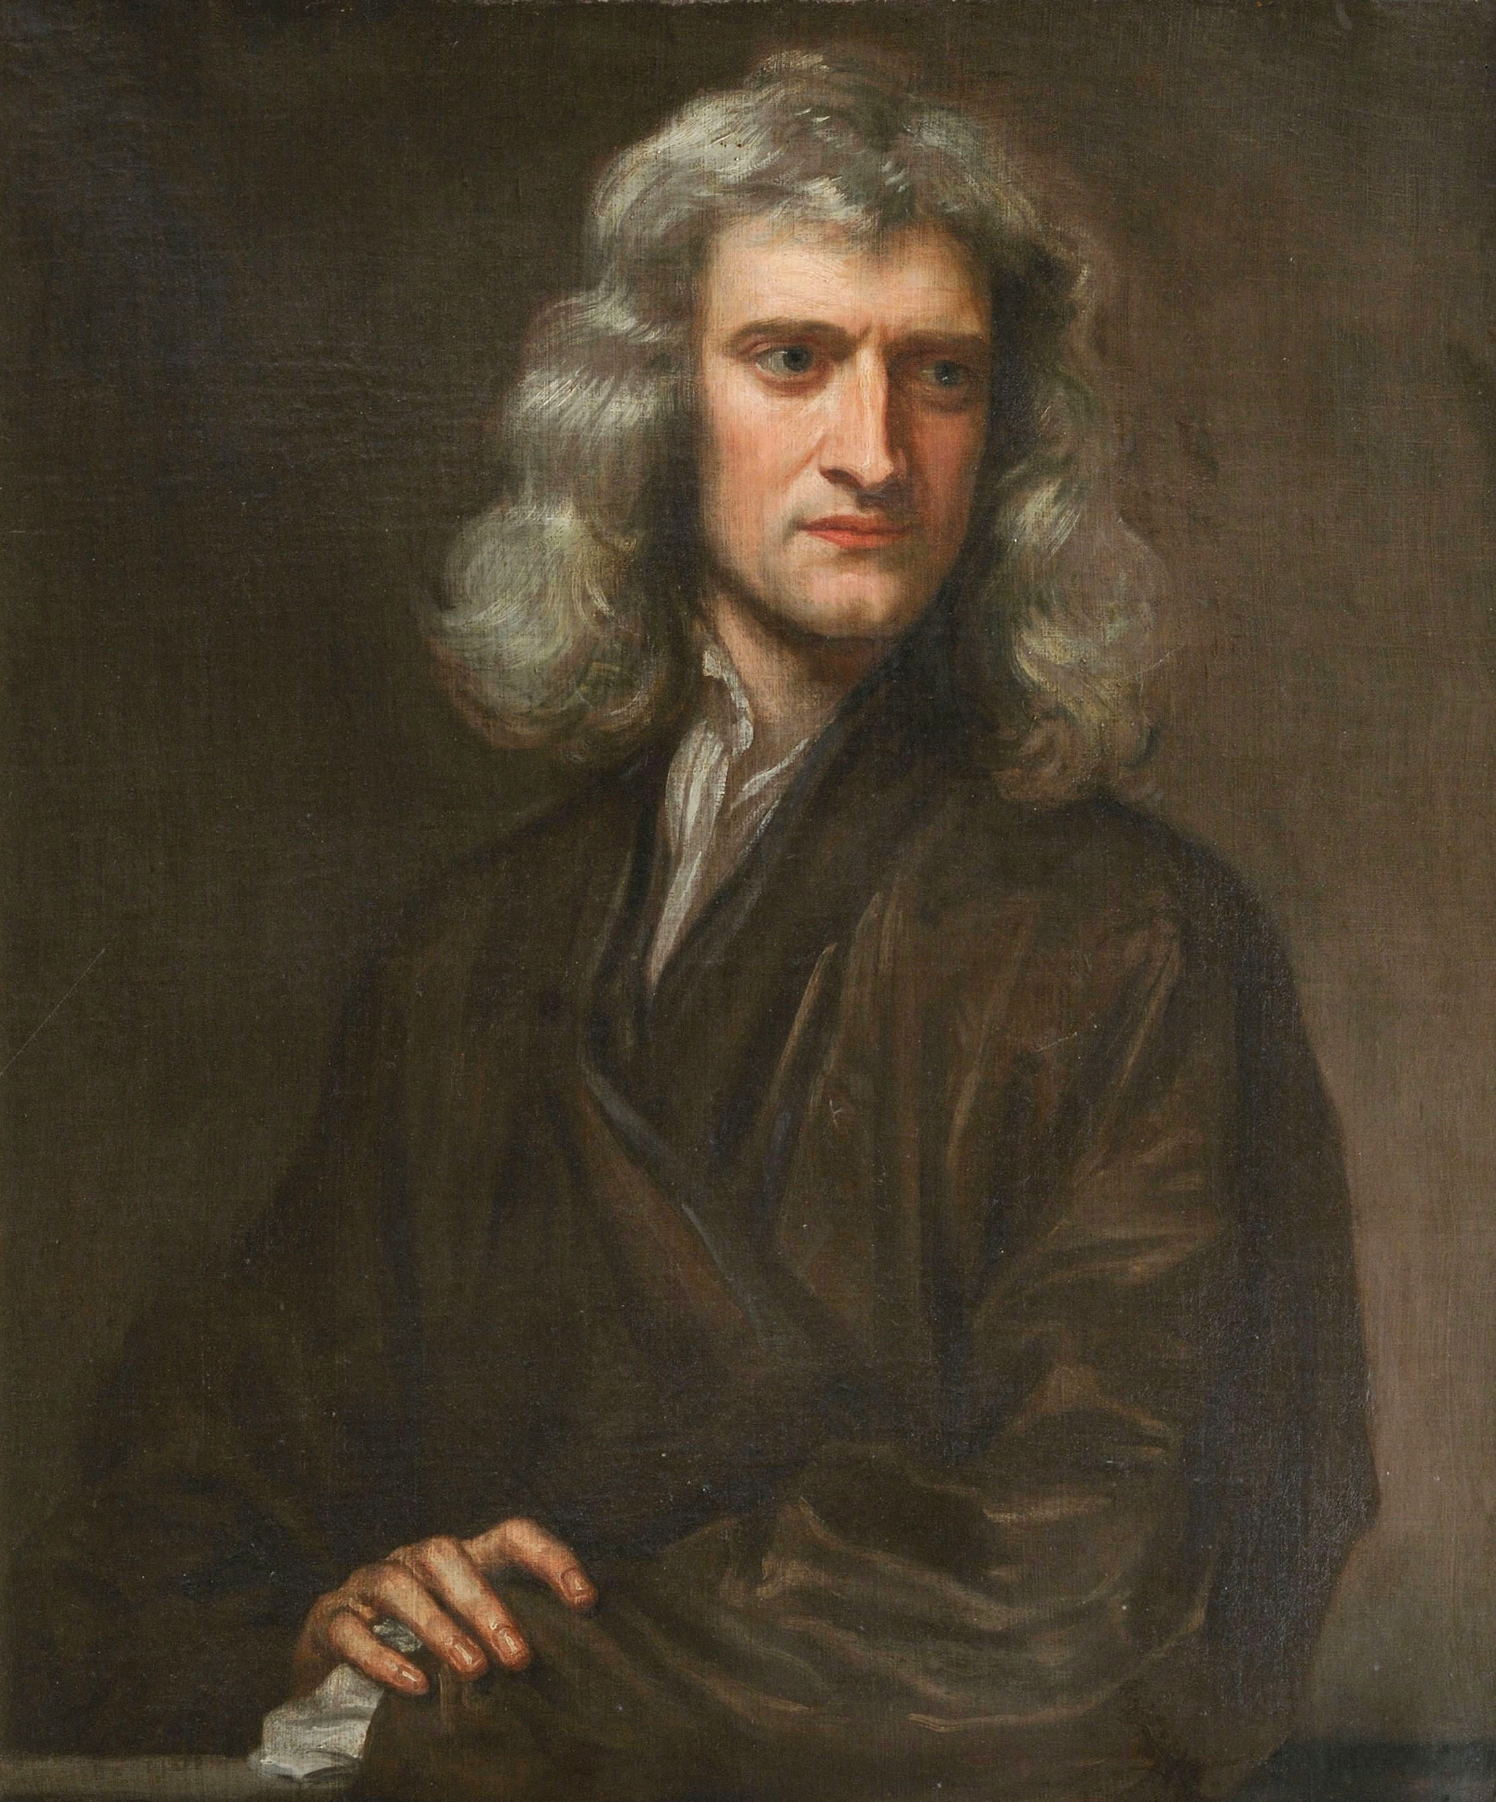
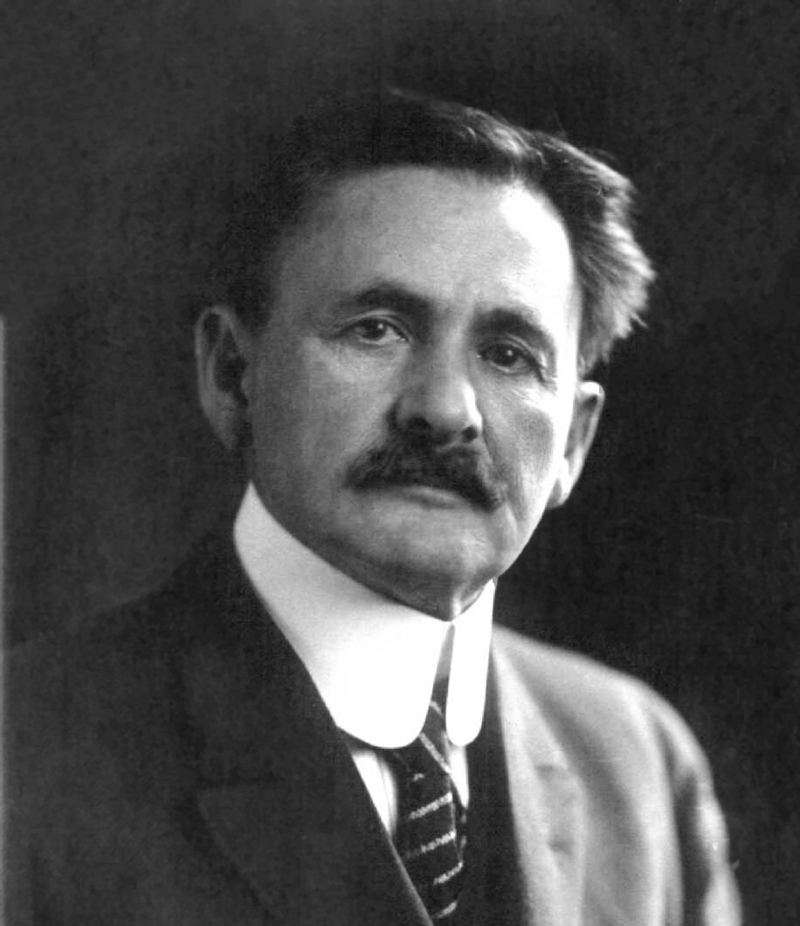
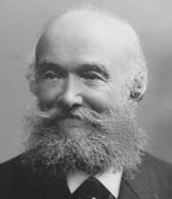
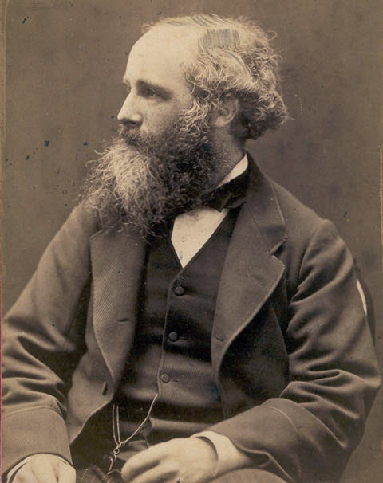
History
In 1687, Sir Isaac Newton studied collisions and formulated a theory that is now known as Newton’s Law of Restitution.
Many scientists such as August Toepler, Albert A. Michelson, and John Clerk Maxwell expanded on his findings to apply to different areas such as electrostatics, molecular collisions, and to determine the restitution coefficient values of various materials

Slide 5
Purpose and objectives of the experiment
Determine the restitution coefficient of a plastic ball falling and bouncing on a stationary poplar wooden plank
Determine if the angle at which the plank is set up affects the restitution coefficient
Determine whether the height at which you drop the plastic ball onto an angled wooden plank affects the angle at which the ball bounces off the plank.
Experiment is split into two parts: 1st part: Flat wooden plank 2nd part: Angled wooden plank

Slide 6
Equations
Restitution coefficient for flat surface collisions: e = vf/vi
Velocity after ball collides with surface: vf=√(2hf*g)
Velocity before the ball collides with surface: vi=√(2hi*g)
Restitution coefficient for angled surface collisions: e = (tan⁡(θi))/(tan⁡(θf))
Percent Error: 100%*|(Experimental-Theoritical)/Theoritical|

Slide 7
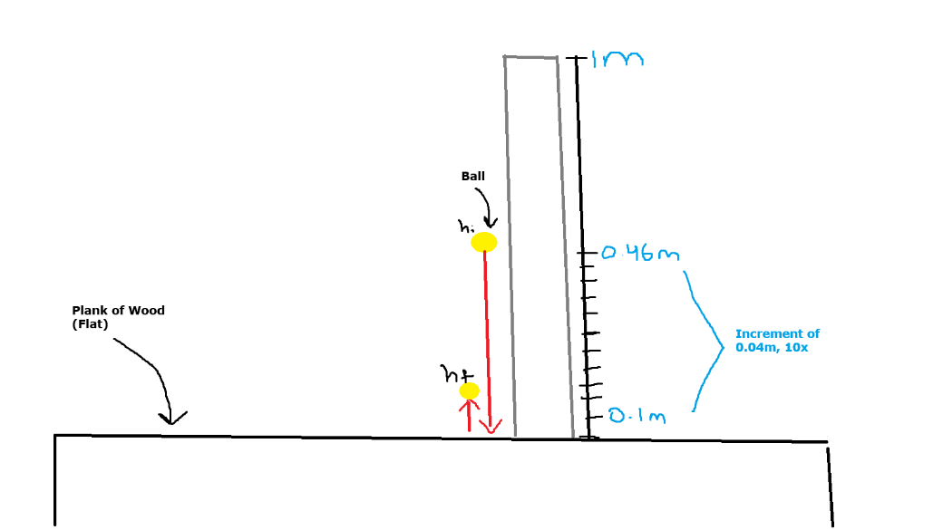
First part: flat wooden plank
Ball is dropped from 10 different heights (hi) of 0.1, 0.14, 0.18, 0.22, 0.26, 0.30, 0.34, 0.38, 0.42, and 0.46m on flat wooden plank
Set meter stick on the wooden plank, use tape to make sure the meter stick stays perfectly vertical
Use slo-mo feature on phone video camera to record the maximum height at which the ball reaches after bouncing once (hf)
Computer simulation of this part of the experiment: https://trinket.io/glowscript/02d0f25fa2.

Slide 8
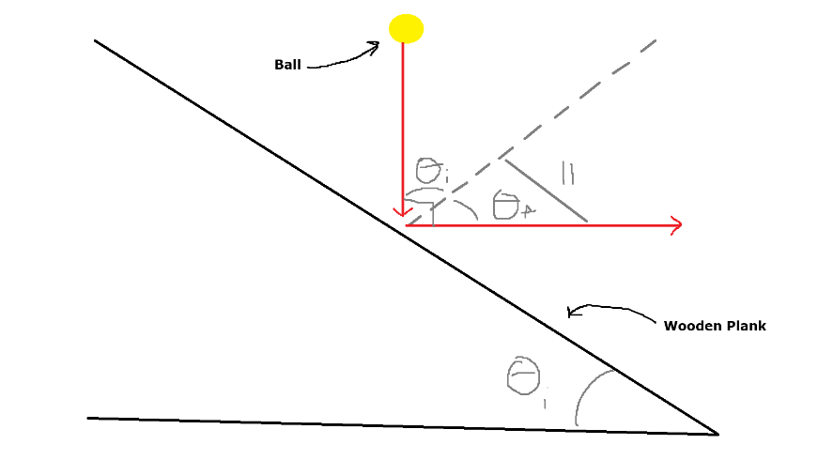
Second part: Angled Wooden Plank
Ball is dropped from 10 different heights (hi), same heights as first part, at 10 different wooden plank angles (θi)
Sketch angles on white poster board going from 0-180 degrees on protractor, set wooden plank along the poster board
Use slo-mo feature in phone video camera to record the ball falling and measure the angle at which the ball bounces off the board.
Computer simulation for this part of the experiment: https://trinket.io/glowscript/1f45f16e8f

Slide 9
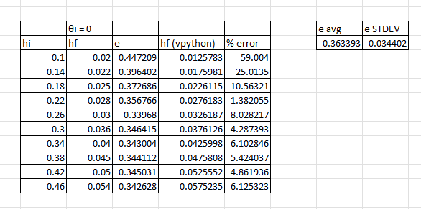
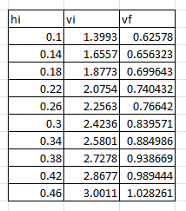
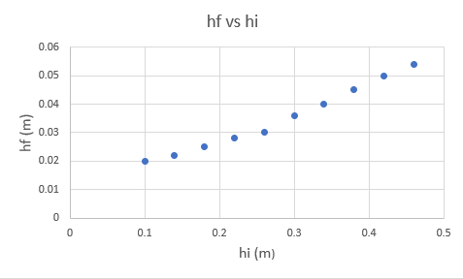
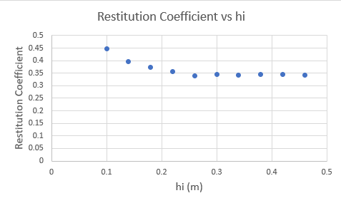
Tables and graphs for first part
Table 1: Recorded initial and final heights as well as the calculated restitution coefficient, theoretical final height, % error (between actual and theoretical final heights), average restitution coefficient , and standard deviation of all restitution coefficient values.
Graph1: Final Height vs Initial Height, with an increase of initial height at which the ball is dropped at, comes with an increase of final height that the ball reaches after bouncing once.
Table 2: Table for recorded initial height, and calculated initial velocity, and final velocity values
Graph 2: Restitution Coefficient vs Initial Height, the initial height at which you drop the ball does not influence then restitution coefficient

Slide 10
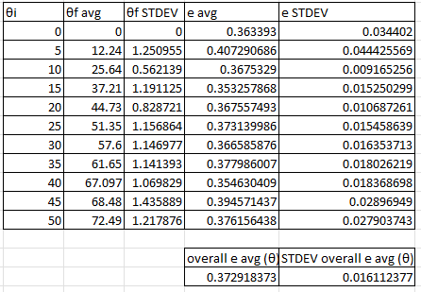
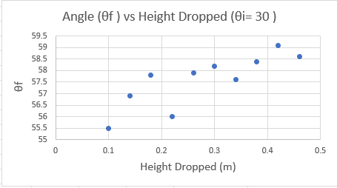
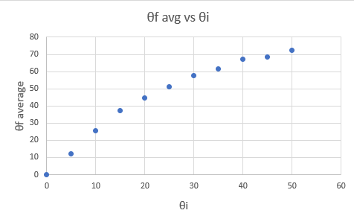
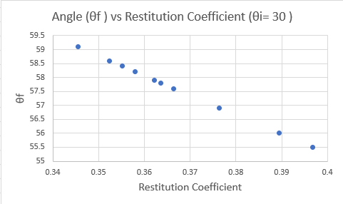
Tables and graphs for second part
Table 1: Recorded initial and average final angle values as well as calculated average final angle, deviation of all the final angles, average restitution coefficient for each initial angle, deviation of all restitution coefficient for each initial angle, overall average restitution coefficient values, and overall deviation of all the restitution coefficient values.
Graph 1: Final Angle vs Height Dropped, the height at which the ball is dropped does not affect the angle at which the ball bounces off the wooden plank.
Graph 2: Final Angle vs Initial Angle, as the initial angle increases, so does the final angle.
Graph 3: Final Angle vs Restitution Coefficient at Initial Angle =30 degrees, the higher the angle at which the ball bounces on the plank, the smaller the restitution coefficient.

Slide 11
Overall findings
The average restitution coefficient in my experiment was 0.372918373 with an uncertainty of ± 0.016112377 and a %error of 2.17%.
The height at which the ball is dropped does not affect the restitution coefficient because as the initial height increases, so does the max height at which the ball reaches after bouncing once, and therefore, e = vf/vi stays the same.
Making the wooden plank incline steeper would not result in a different restitution coefficient because as the initial angle increases, so does the angle at which the ball bounces off, and therefore, e = (tan⁡(θi))/(tan⁡(θf)) remains the same.
The height at which you drop the ball does not affect the angle at which the ball bounces off the angled wooden plank the angle is solely dependent on the initial angle at which the ball approaches the wooden plank with respect to its perpendicular (also at what angle is the plank angled at).

Slide 12
Concluding Statements
Reason for error could be attributed to the ball not hitting the same exact spot on the wooden plank every time.
How to expand on this experiment: Use different materials for both the ball and surface Use different shapes for both the ball and surface Test whether the restitution coefficient values stays the same in different temperatures

Slide 13
Questions?

Slide 14
Bibliography
[1] Ashish, ‘Coefficient Of Restitution: Definition, Explanation And Formula’, https://www.scienceabc.com/pure-sciences/coefficient-of-restitution-definition-explanation-and-formula.html, Accessed December 6th, 2023
[2] Stanford Encyclopedia of Philosophy, ‘Newton’s Philosophiae Naturalis Principia Mathematica’, https://plato.stanford.edu/entries/newton-principia/, Accessed December 6th 2023
[3] Wikipedia, ‘August Toepler’, https://en.wikipedia.org/wiki/August_Toepler, Accessed December 6th, 2023.
[4] Wikipedia, ‘Albert A. Michelson’, https://en.wikipedia.org/wiki/Albert_A._Michelson, Accessed December 6th, 2023
[5] MacTutor, ‘James Clerk Maxwell’, https://mathshistory.st-andrews.ac.uk/Biographies/Maxwell/, Accessed, December 6th, 2023

